Slide 1
The effects of predicted climate change on Batrachochtrium dendrobatidis from across the United States
MS Student: Ciara Sheets
Advisor: Jamie Voyles
University of Nevada, Reno

Slide 2
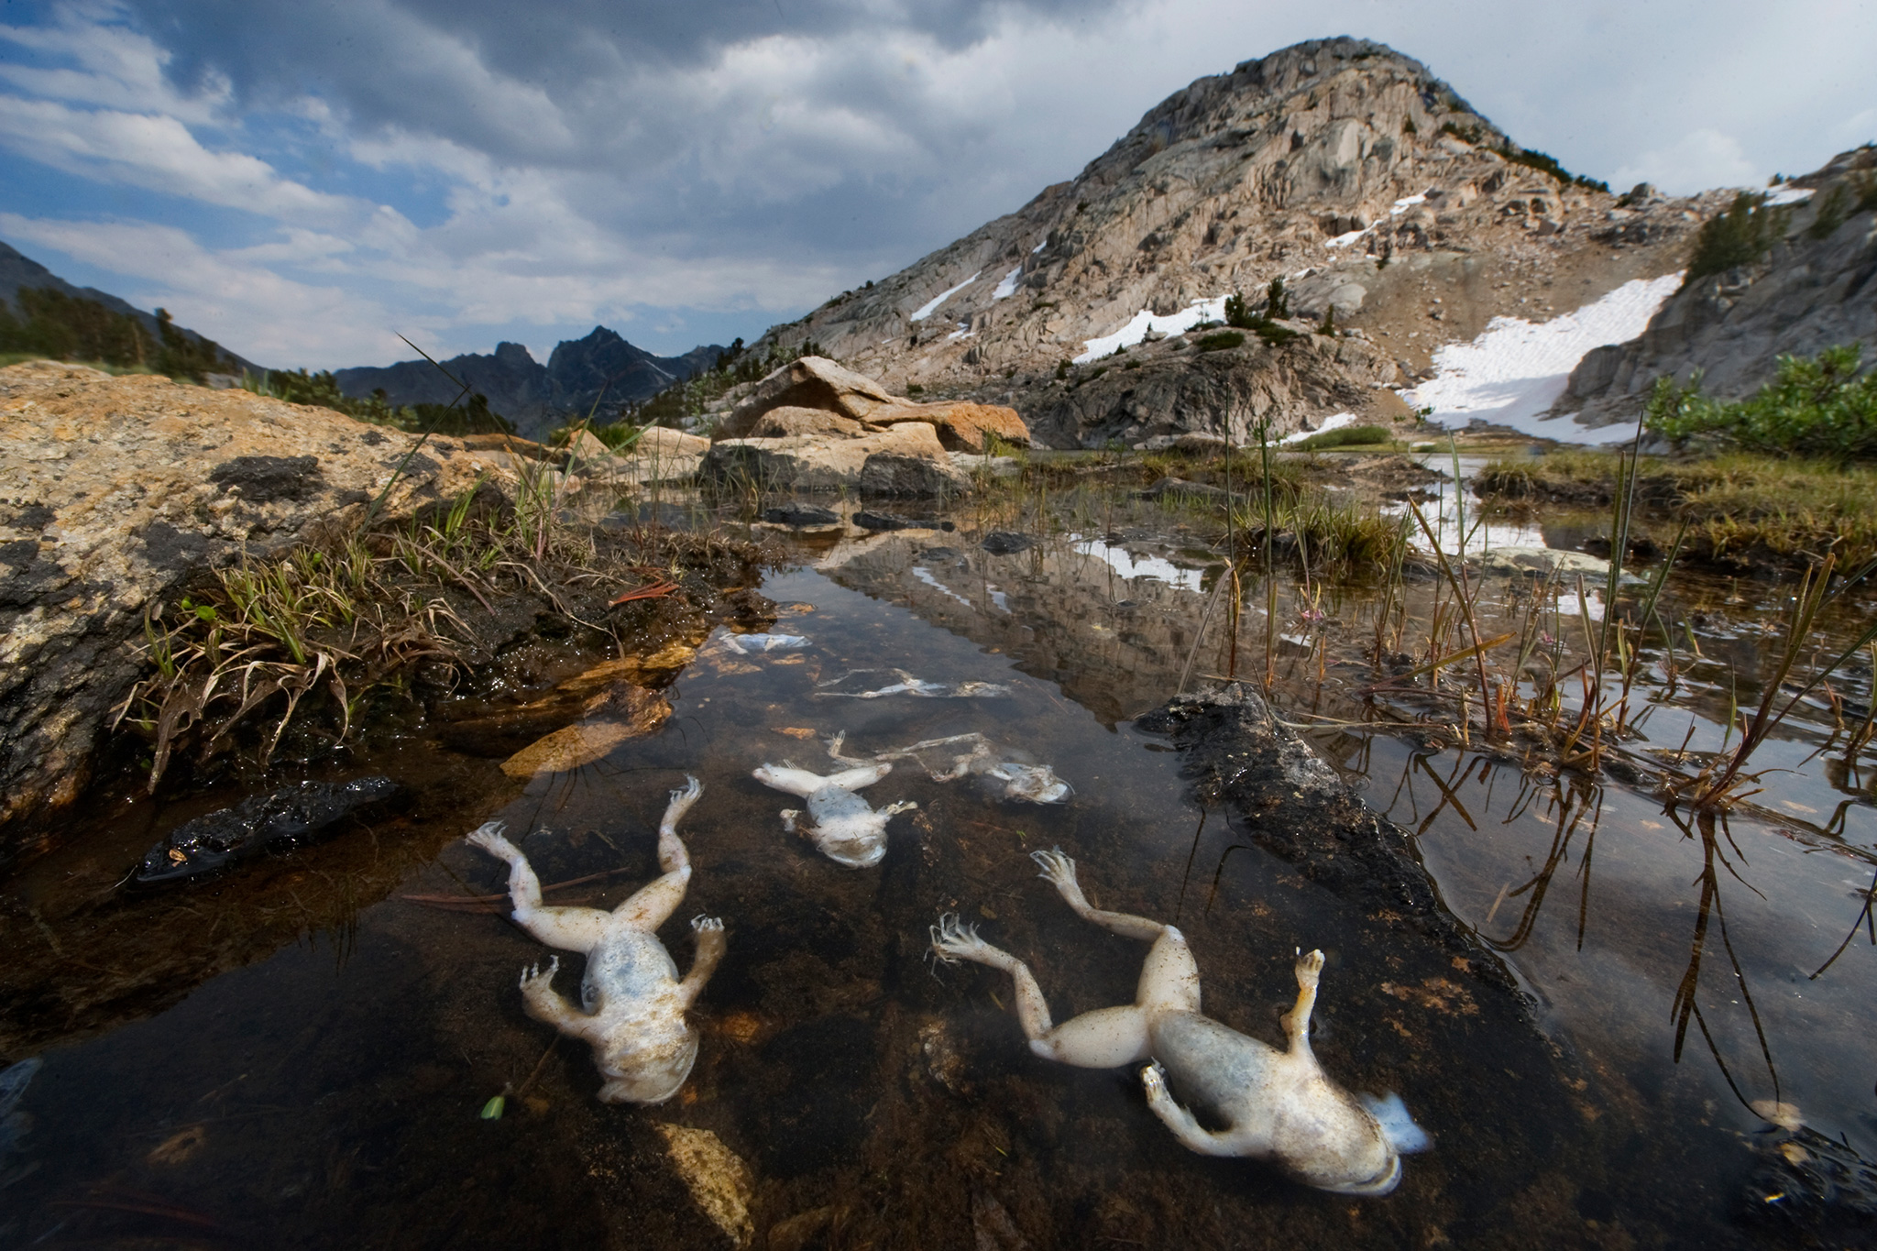
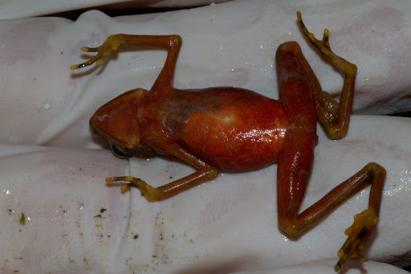
Chytridiomycosis: The Disease
Caused by fungal pathogen
Occurs around the globe and causes massive population declines
Susceptibility is variable across species
More severe disease correlated with higher pathogen load
Image:Brian Gratwicke
Image: Joel Satori
Notes:
Joel satori

Slide 3
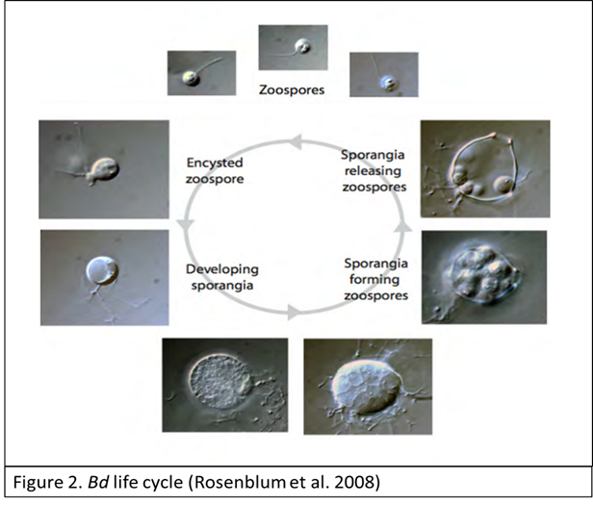
The pathogen: Batrachochytrium dendrobatidis (Bd)
Asexual, spherical, Eukaryotic fungal pathogen
Two life-stages:
Motile zoospore, Sporangia
Develops in the keratinized skin of amphibians
Causes Chytridiomycosis

Slide 4
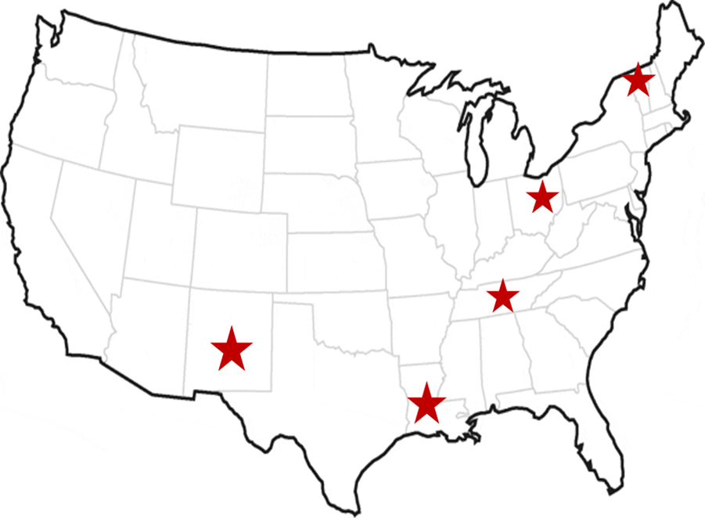
Isolates Collected from 5 Regions of the U.S.

Slide 5
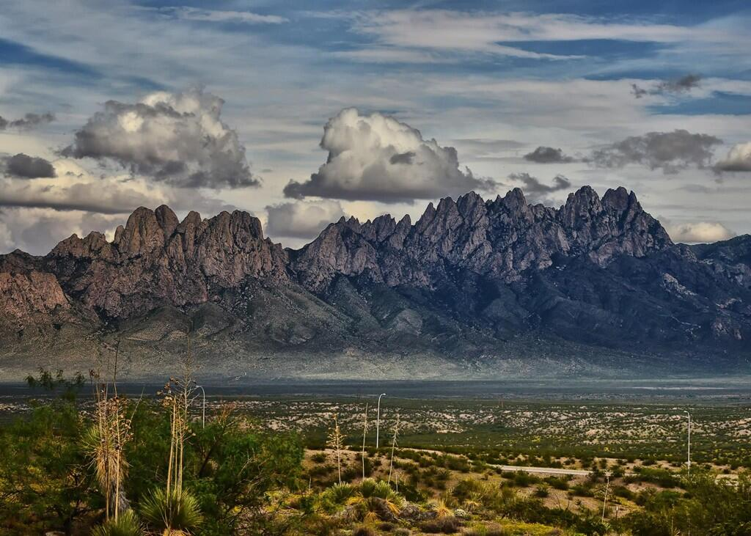
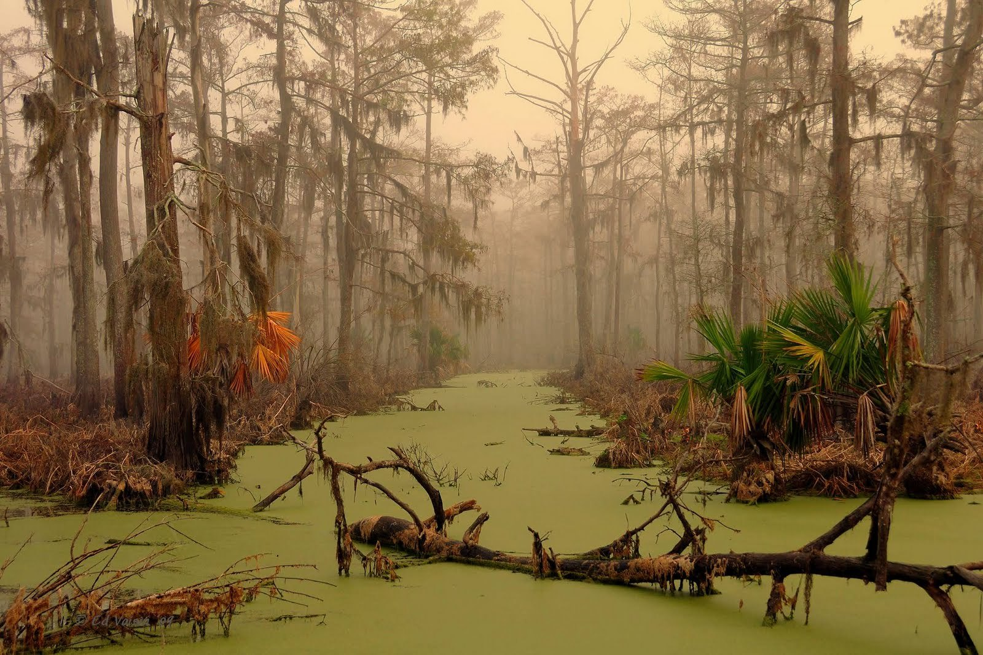
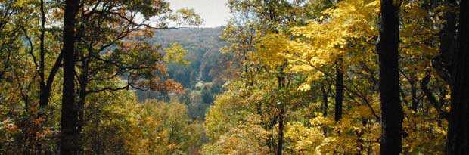
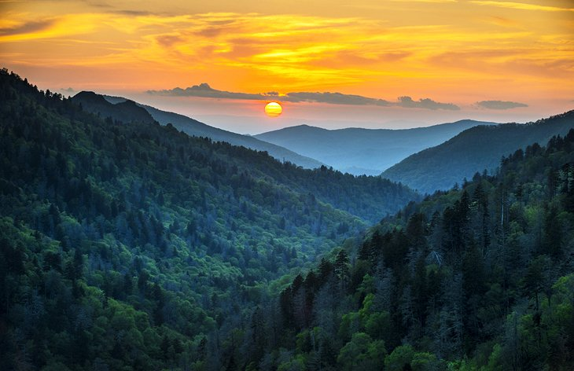
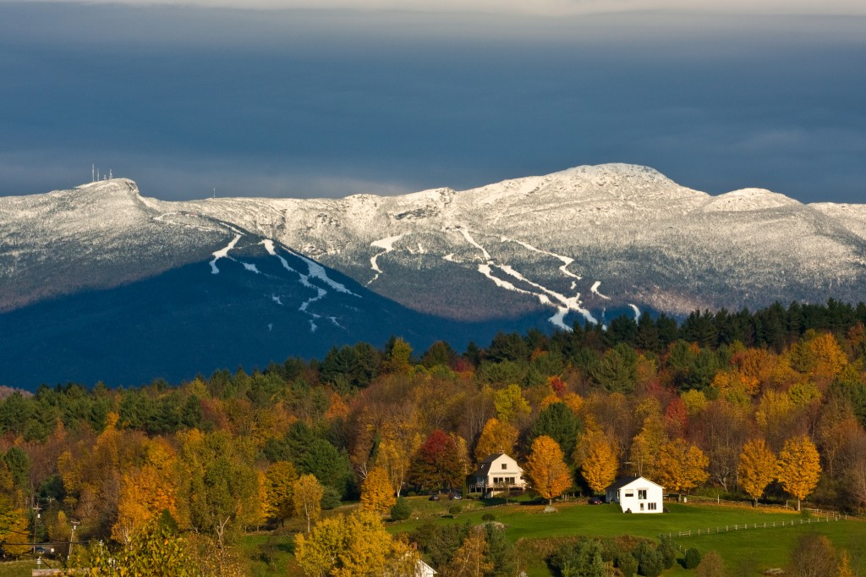
New Mexico
Louisiana
Each Region varies in:
Latitudinal position
Elevation gradient
Daily temperature fluctuation
Seasonality
Ohio
Tennessee
Vermont
Chiriqui, Panama

Slide 6
Methods: Defining Thermal Performance Range
Collect Bd isolates
Cultured isolates at various temperatures across known thermal range and measure growth over time
Used an MTT viability assay to measure growth

Slide 7
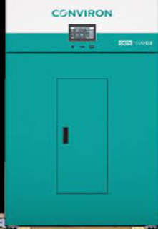

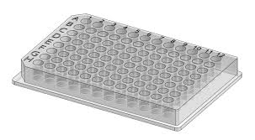
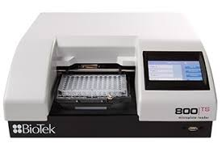
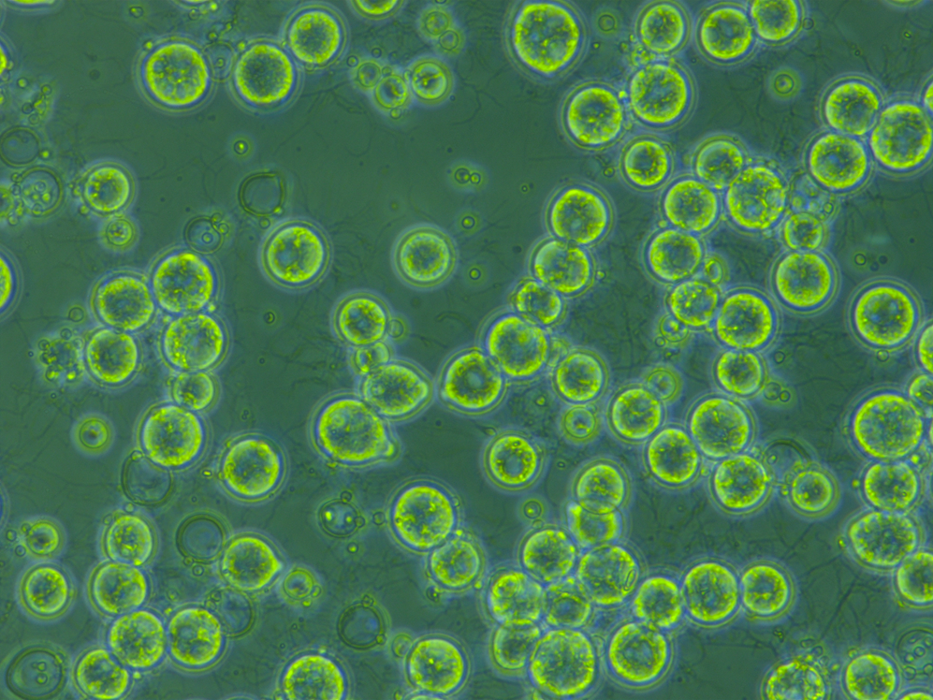
in vitro Experiment
Filter out sporangia & plate isolates
Incubate plates in assigned chamber
Isolate
Optical Density
(whole culture growth)
Stable
21°C
Culture
+
TGHL

Slide 8
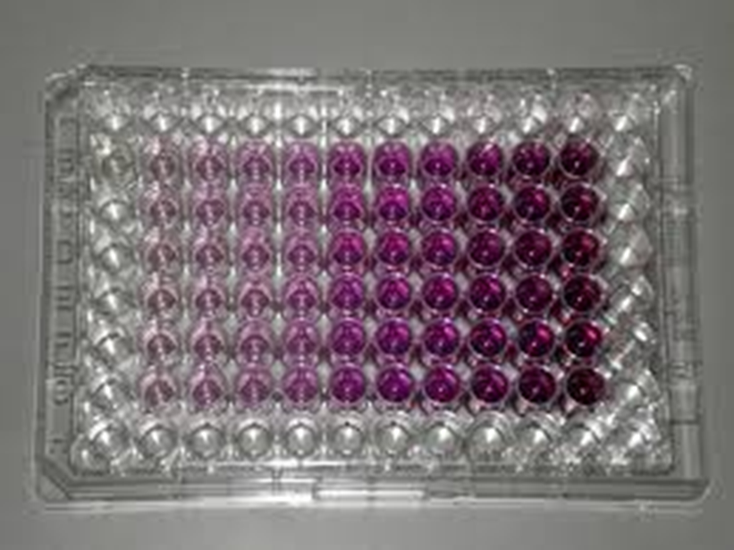
MTT Assay
Colorimetric Assay that measures metabolic activity
Yellow MTT is reduced to purple
Purple formazan solubilized using SDS detergent agent
Measured spectrophotometrically yielding absorbance

Slide 9
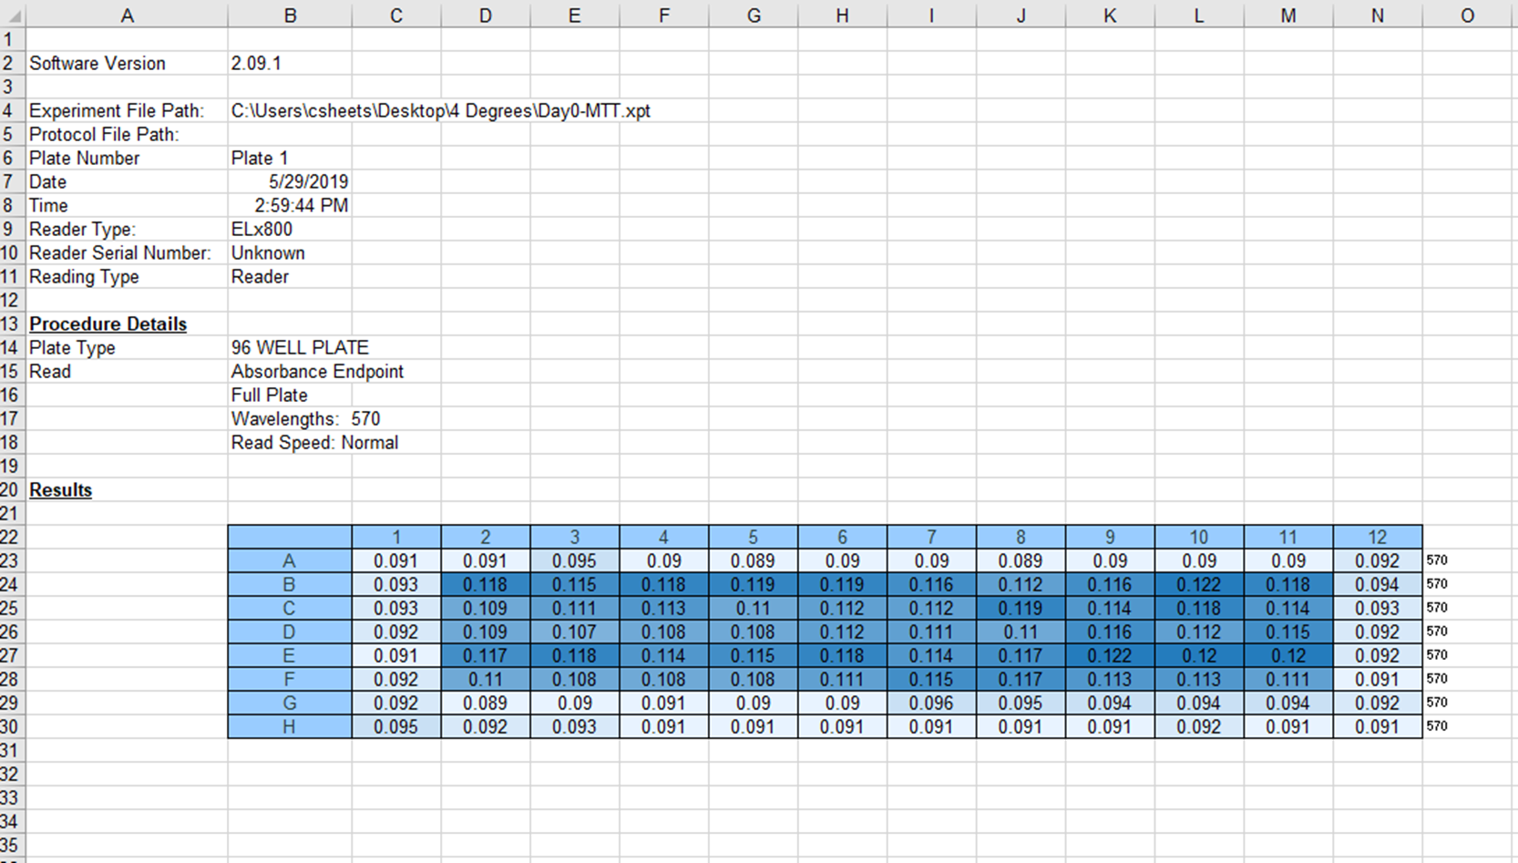
Reading Output as Excel File
LA
OH
TN
NM
VT

Slide 10
Bio Project: Goals
Take excel file from reader & create new df without manual entry
Be able to add each new day's file to new df with same code
Have an efficient way to QAQC

Slide 11
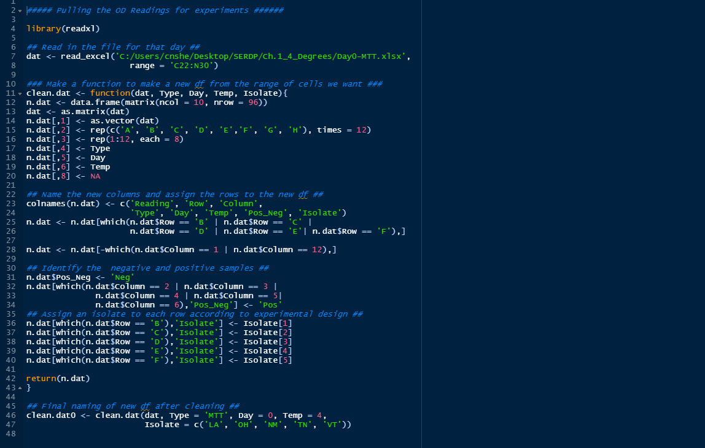
Code:

Slide 12
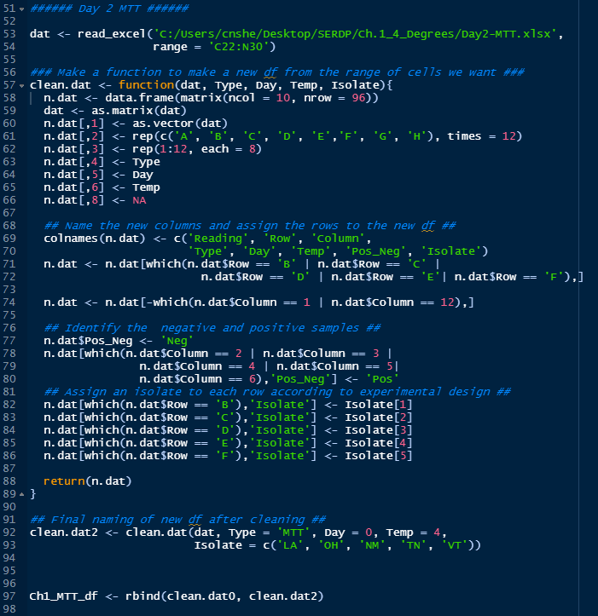
Code:

Slide 13
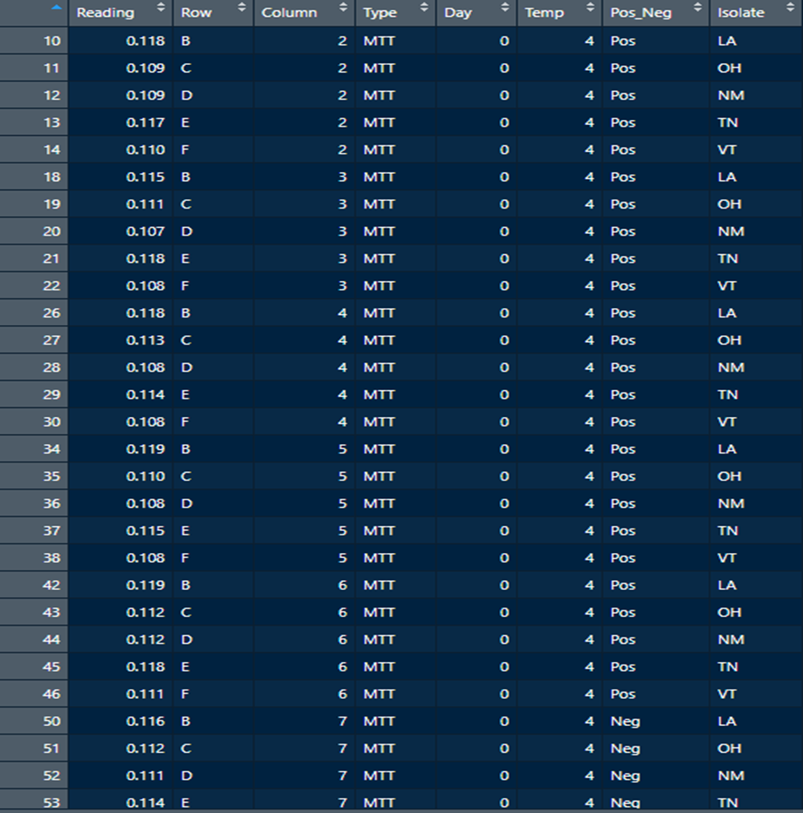
Finished Data Frame

Slide 14
Bio Project: Secondary Goals
Make some newer figures that display all my data
Work on sophistication of visualizations

Slide 15
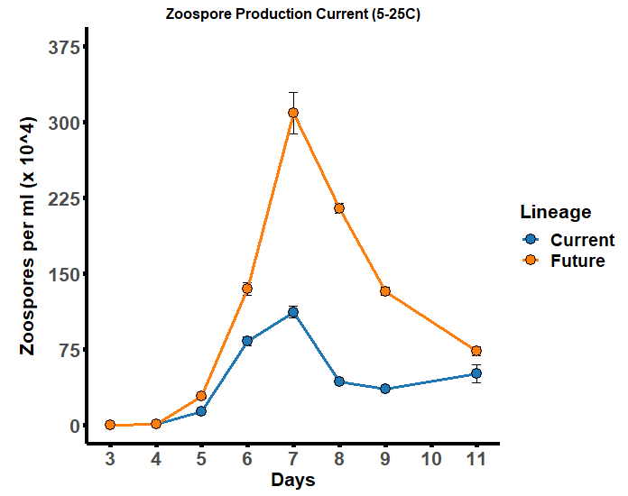
Old Plot:

Slide 16
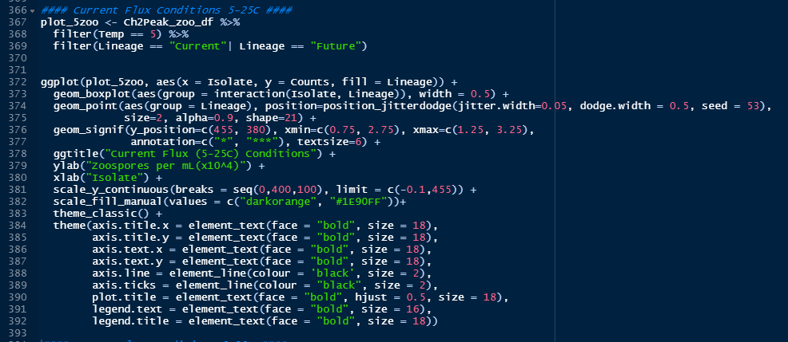
Code:

Slide 17
